Slide 1
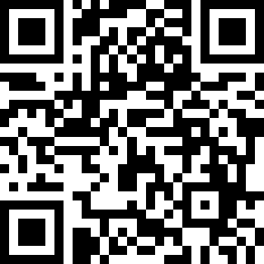
State of CS Education Washington 2025
https://tinyurl.com/stateofcsewa25
Lawrence Tanimoto
Treasurer/Advocacy Lead
CSTA Washington
4

Slide 2
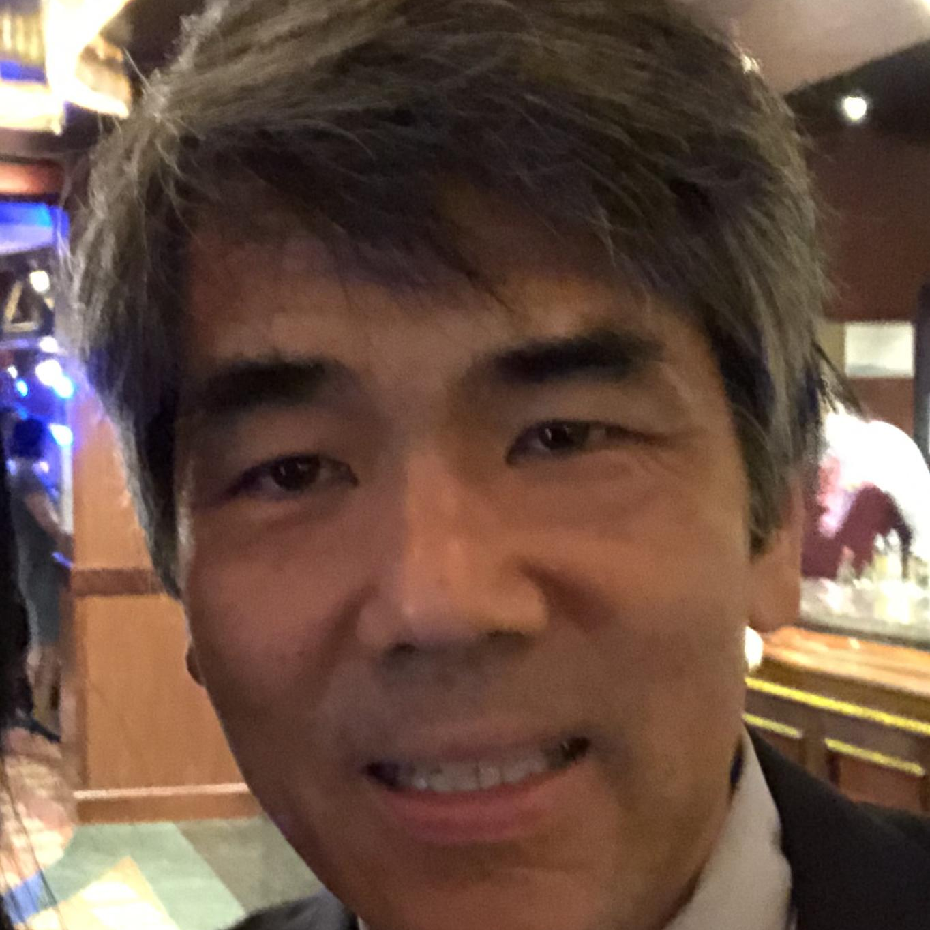
Lawrence Tanimoto
Treasurer/Advocacy Lead, CSTA Washington
Retired
Teacher (CTE) at Ingraham High School in north Seattle from 2014-2021
28 years in international computer industry last 18 with Microsoft
l
https://www.linkedin.com/in/lawrence-tanimoto/

Slide 3
Disclaimer
The views and opinions expressed in this presentation are solely my own and do not necessarily reflect the views, positions, or policies of any organizations or individuals I am affiliated with. Any errors or misinterpretations are mine alone.

Slide 4

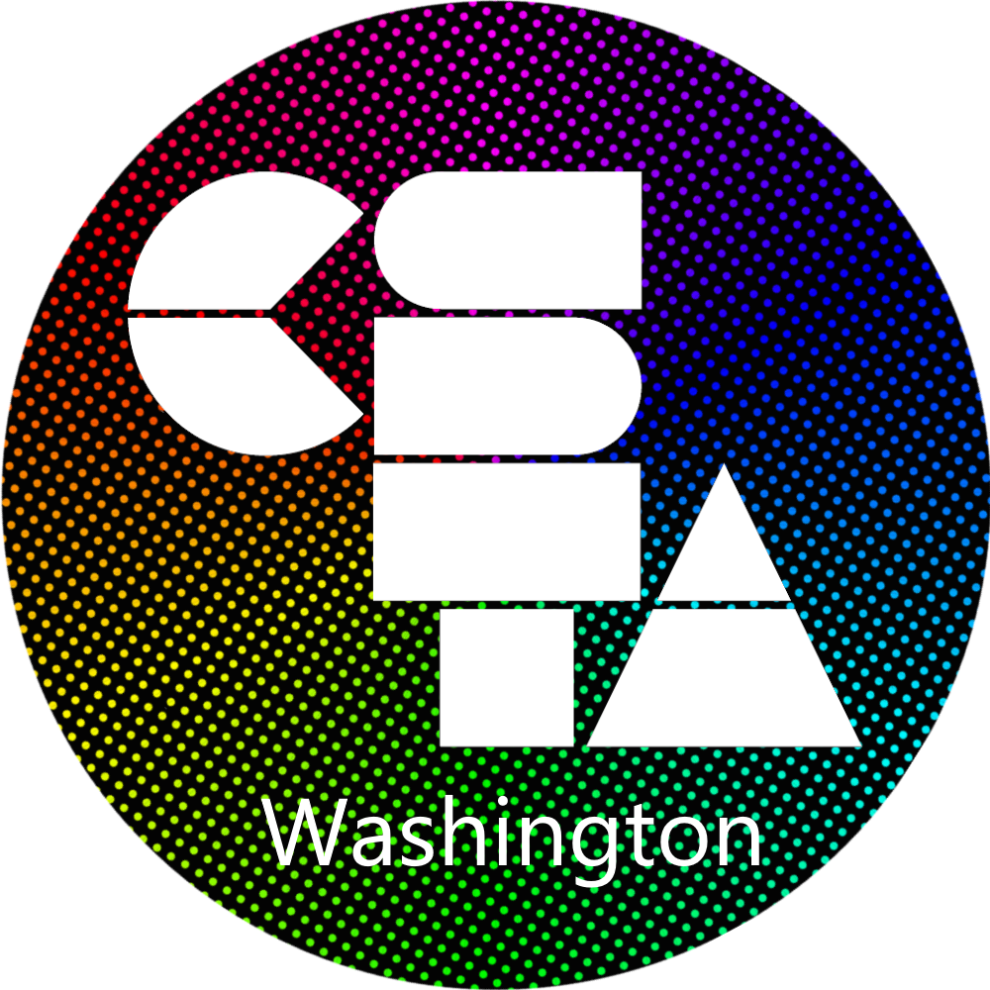
Computer Science Teachers Association
Merger of 4 CSTA chapters in Washington (Nov 2025)
Puget Sound
Central Washington
Mid-Columbia
Spokane
Unified Membership and Association Management System migration (Mar 2025)
https://washington.csteachers.org
Provide community, professional development, support, and advocacy for computer science teachers throughout Washington and help them provide equitable, high-quality CS education to all K-12 Washington state students.

Slide 5
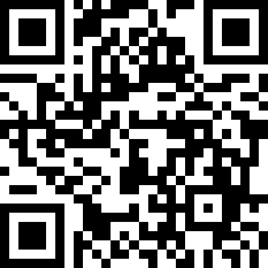
Survey and Clock Hours
QR Code Here
3 free STEM clock hours available for all interested attendees
Please confirm attendance on sign up sheet today
Please fill in survey by EOD 4/29/2025

Slide 6

My CS Education Story
Started teaching CS (CTE) at Ingraham High in 2014
CS Education in Washington must be great!
Retired in 2021, and looking for something to do, started investigating
National and Washington CS Education metrics, and
Washington CS Education policy
CS Education in Washington is mediocre!

Slide 7
State of CS Education Washington
Notes:
https://ospi.k12.wa.us/student-success/resources-subject-area/educational-technology-edtech/educational-technology-learning-standards?utm_source=chatgpt.com

Slide 8
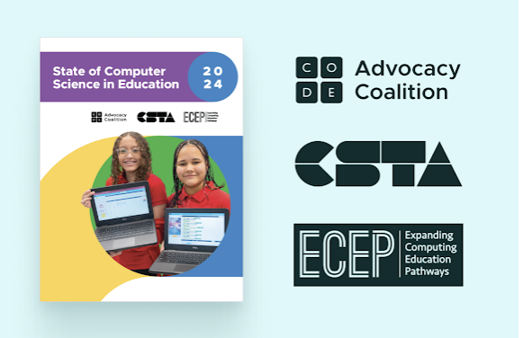

State of Computer Science In Education (2024)
Code.org Advocacy Coalition
Computer Science Teachers Association
ECEP Alliance
WA Affiliate: CSforAll Washington

Slide 9
Access and Participation Data

Slide 10
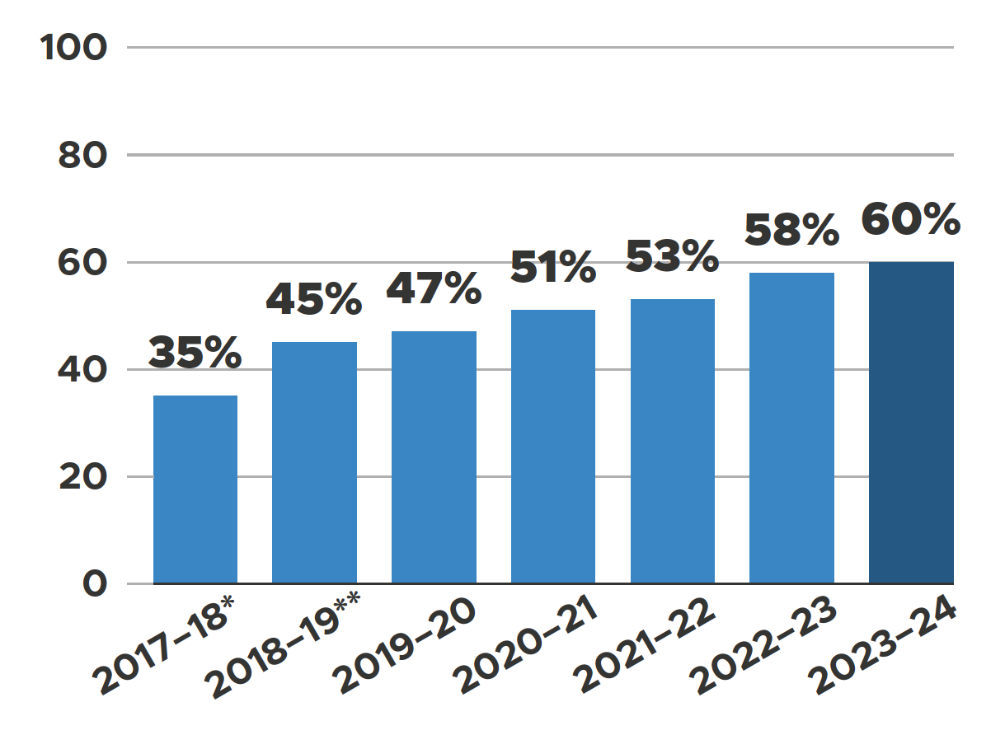

High Schools Offering CS
Over Time
National Access to Computer Science
*Based on 24 states
**Based on 39 states

Slide 11
What percentage of Washington HS Offer Computer Science?
according to 2024 State of CS Ed Report
A) 78%
B) 67%
C) 59%
D) 50%
E) 45%

Slide 12
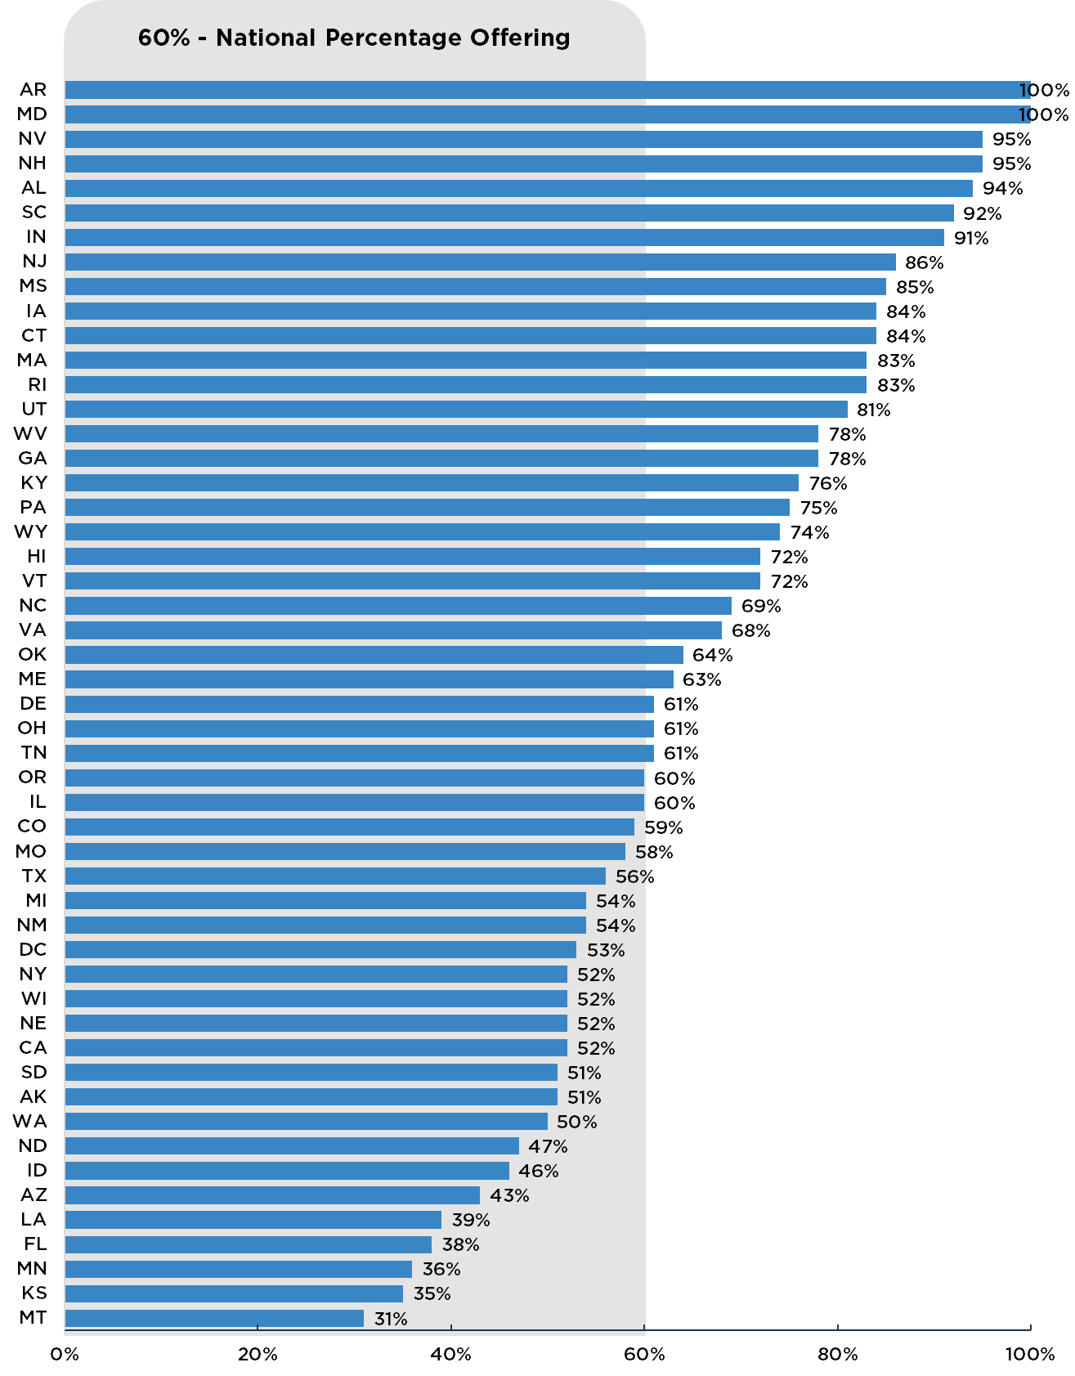
U.S. Schools Offering Computer Science

Slide 13
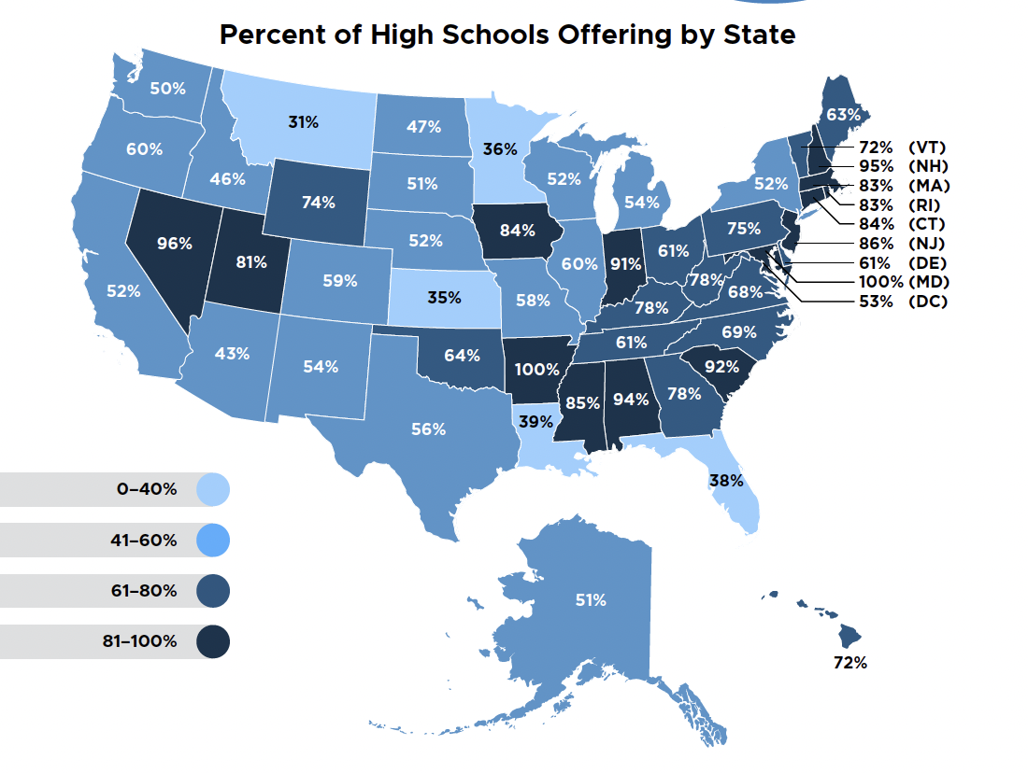
High Schools Offering CS
Notes:
14 states now have over 80% of HSs offering, compared to 11 last year.

Slide 14
Disparities in Access
Disparities in Access
Small high schools
High free and reduced lunch population high schools
These disparities are most stark in small schools and schools with high FRL populations
Notes:
We define small high schools as those under 500 students and these schools struggle the most of offer computer science classes

Slide 15
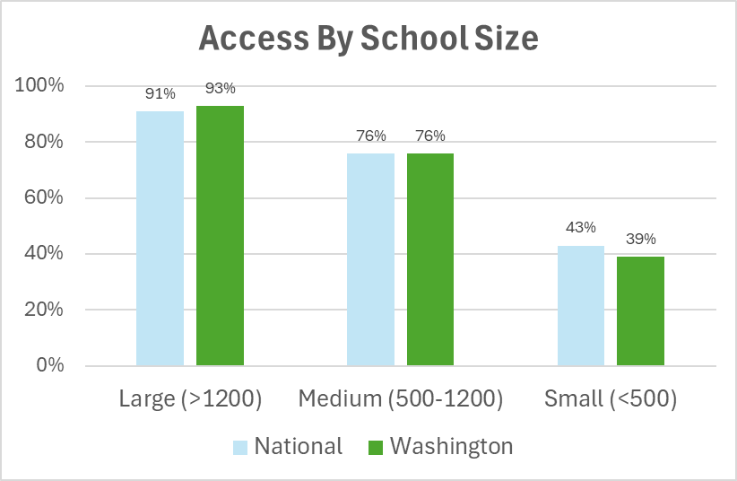
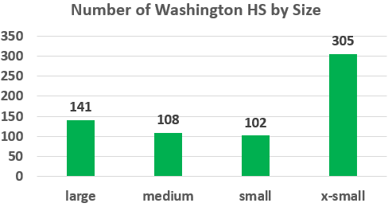
Effect of School Size
250 -500
< 250
From OSPI 2022-23 K–12 Computer Science Education Data Summary Report
Notes:
X_small (<250)
Small <500 (national 43%)
Medium 500 – 1200 (national 76%) Large 1200+ (national 91%)

Slide 16
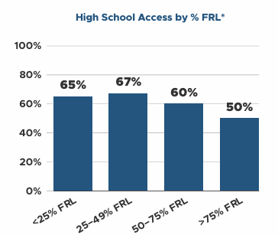
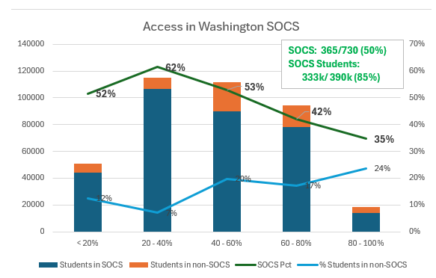
Effect of High Percentage FRL Students
Effect of High FRL Student Rates
National Data
SOCS – Schools Offering CS
For more details, see Lawrence’s blog post
Notes:
SOCS – Schools Offering CS
Based on data from OSPI 2021-22 K-12 Computer Science Education Data Summary Report
For more details, see Lawrence’s blog post

Slide 17
From Access to Participation (National)
From Access to Participation (National)
It is necessary for all schools to provide access to computer science courses for all students.
But that is just the first step to ensuring all students actually participate in these courses.
82%
6%
of U.S. high school students attend a school with a computer science course
of high school students enrolled in a computer science class last school year
Notes:
This is crucial for folks to understand that we have two distinct though related challenges

Slide 18
From Access to Participation (National)
From Access to Participation
 | National | Washington
% of HS Offering CS | 60% | 50%
% of HS Students in HS Offering CS | 82% | 87%
% of HS Students Enrolled in CS | 6%
Notes:
This is crucial for folks to understand that we have two distinct though related challenges

Slide 19
What percentage of Washington HS students participate in Computer Science?
according to 2024 State of CS Ed Report
A) 7.2%
B) 6.2%
C) 5.1%
D) 4.5%
E) 3.9%

Slide 20
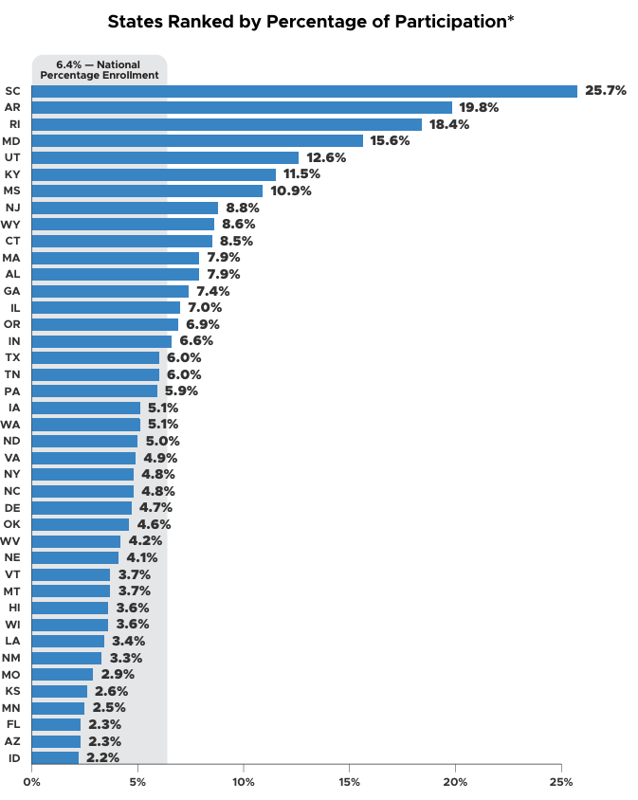
Washington Below National Average in CS Participation
Notes:
About 87% of Washington students attend a high school that offers CS compared to 82% nationwide

Slide 21
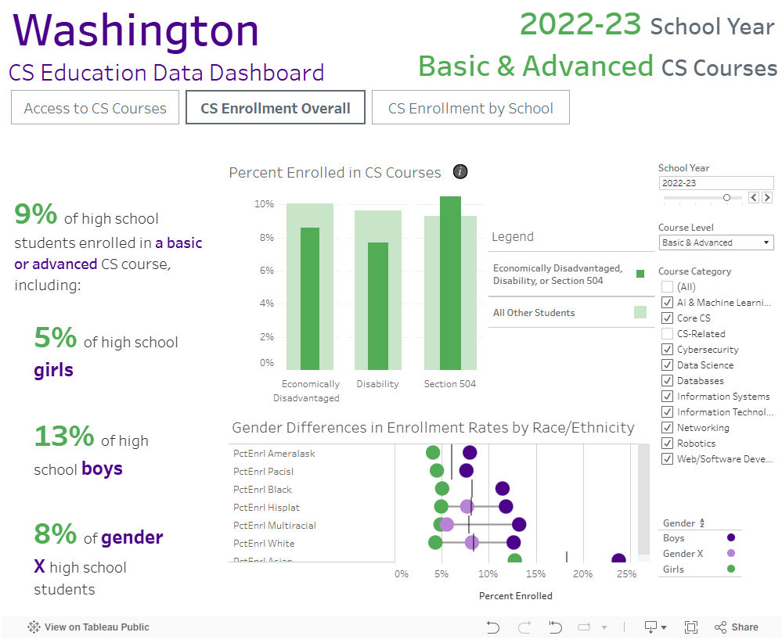
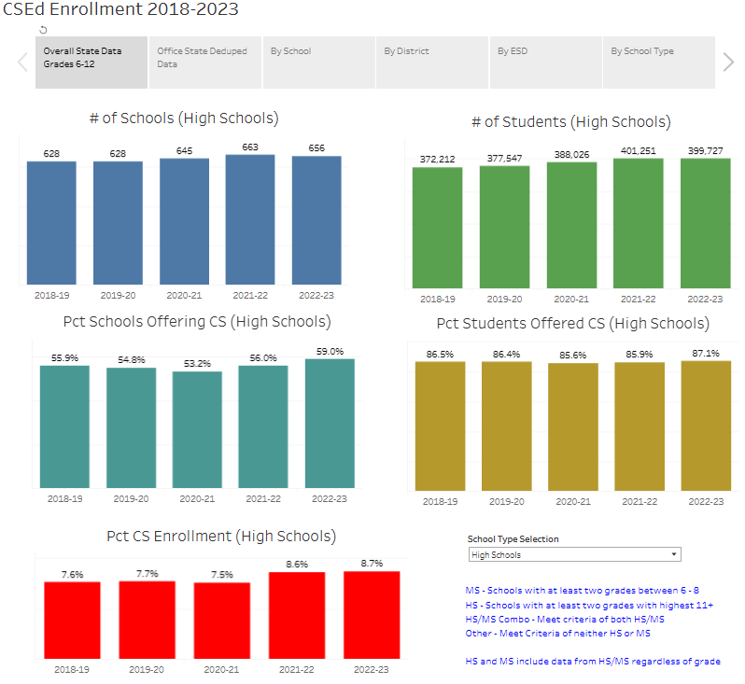
Alternate Data Dashboards
9% enrollment https://bit.ly/ecepdash
Project data provided by OSPI through ECEP Common Metrics Project
8.7% enrollment https://csforallwa.org/data OSPI 2022-23 K–12 Computer Science Education Data Summary Report.

Slide 22
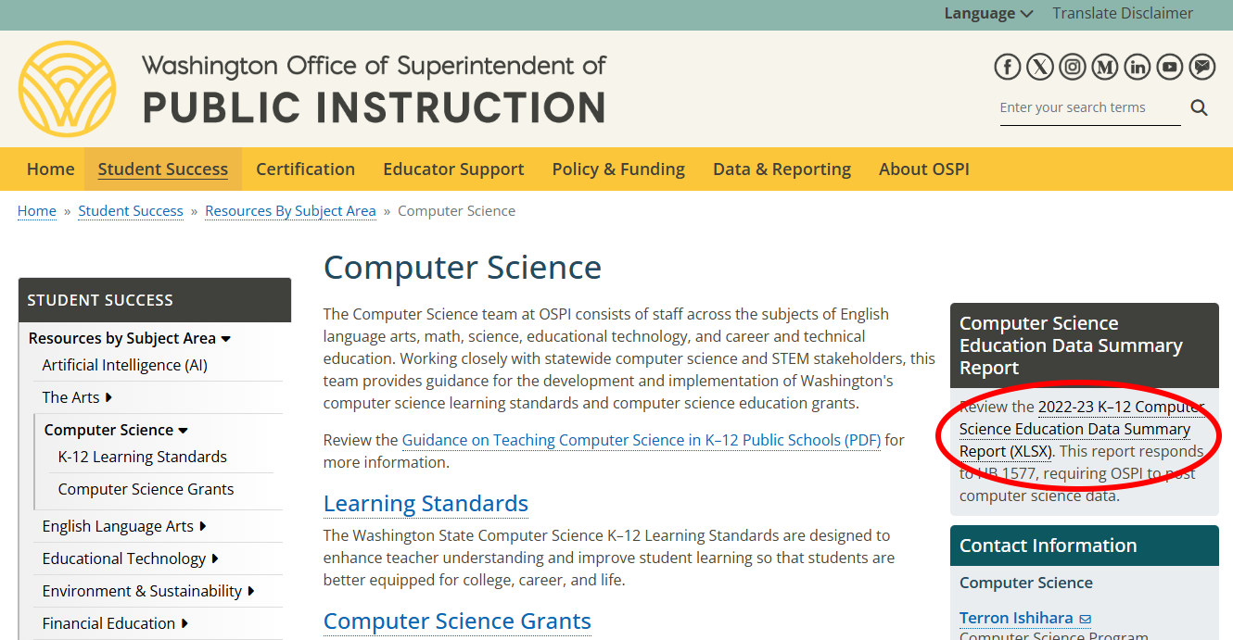
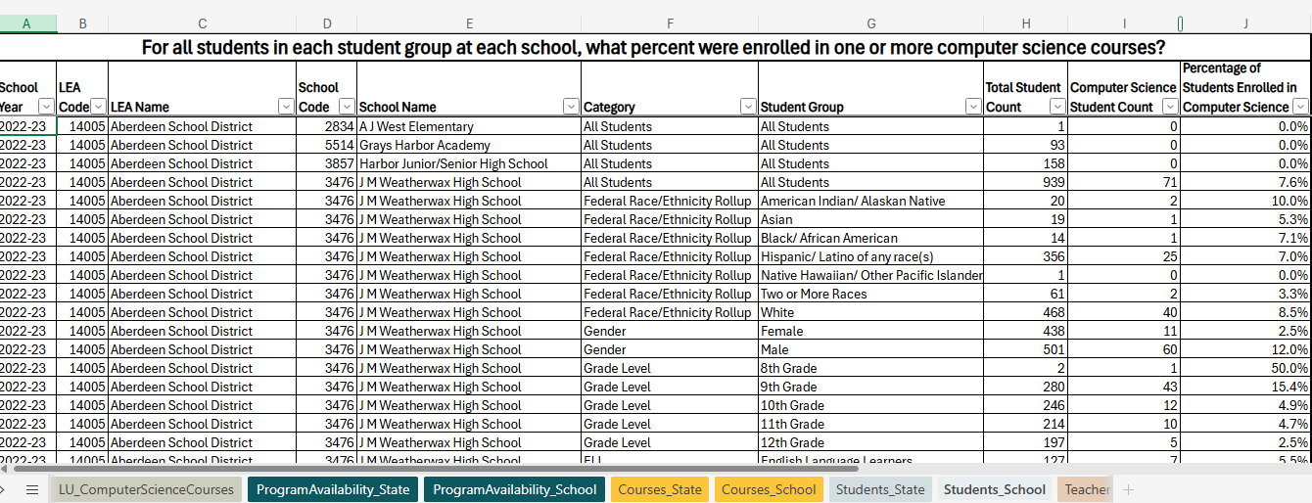
K-12 Computer Science Education Data Summary Report
OSPI Computer Science Home

Slide 23
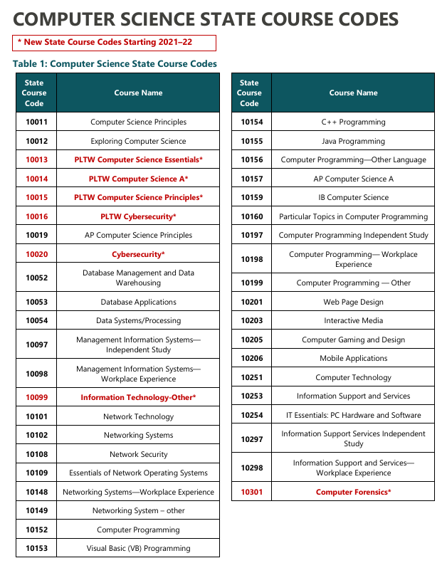
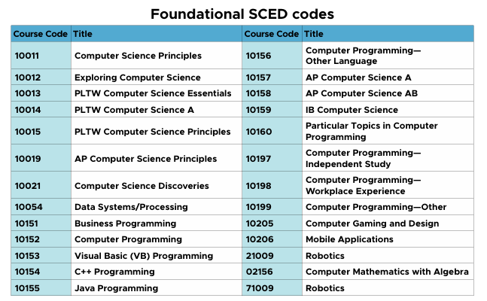
Explaining Data Differences
OSPI Active vs. Passive Involvement
Definition of high school
Definition of computer science
GUIDANCE ON TEACHING COMPUTER SCIENCE IN WASHINGTON STATE K-12 PUBLIC SCHOOLS

Slide 24
Demographic Data

Slide 25
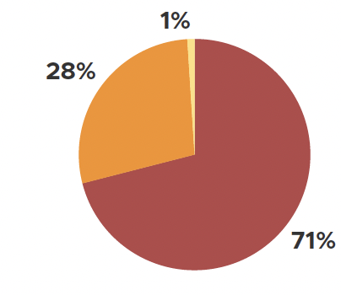
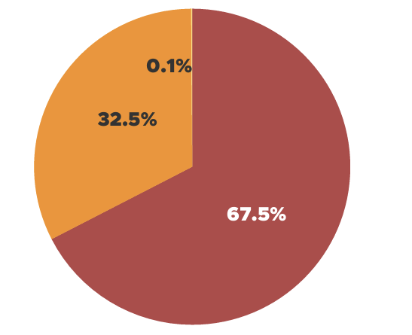
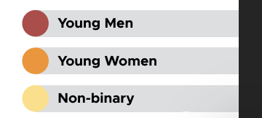
Gender Participation
National
Washington
Notes:
Nationally, we have not seen this number change much over the past 5 years.
Participation by high school female students lags in all states

Slide 26
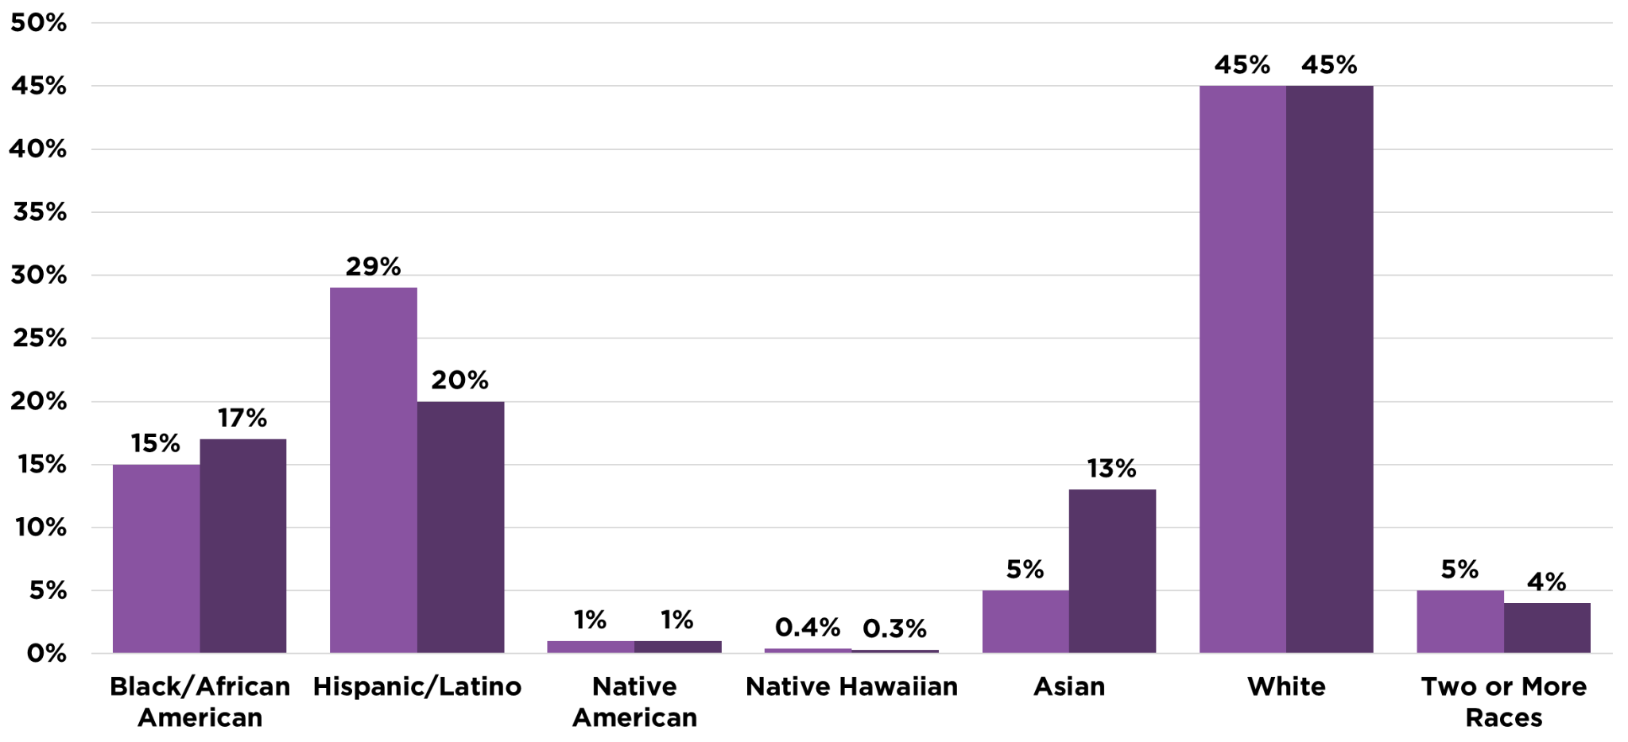
National Participation by Race/Ethnicity
Participation by Race/Ethnicity (National)
National Student Demographics
Students enrolled in CS classes
Notes:
Nationally, the biggest participation gap is for Hispanic students, but this varies across states.

Slide 27
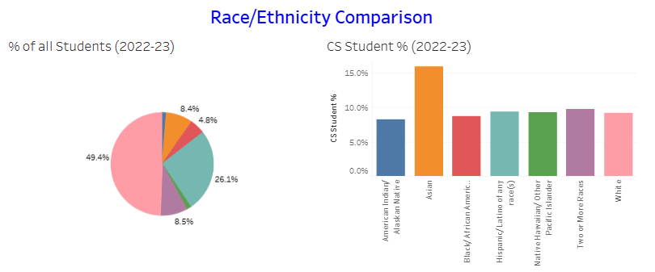
Washington Participation by Race/Ethnicity
Participation by Race/Ethnicity (Washington)
National Participation by Race/Ethnicity
from Washington CS Education Demographics 2018-23 on https://csforallwa.org/data
Notes:
In Washington, Asians 16.0%, Two or more (9.8%), Hispanic/LatinX (9.4%), and Hawaiian/pacific Islander (9.3%) all have higher participation rates than Whites 9.2%). Blacks and Native Americans still trail. The relative participation of Asians vs. Whites in Washington is 174% vs. Nationally at 260%
Relative participation

Slide 28
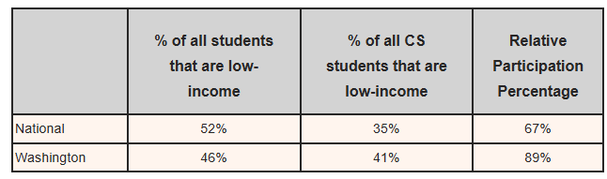
Participation by Income Level
Participation by Income Level
Washington Participation by Race/Ethnicity
National Participation by Race/Ethnicity
From Lawrence’s blog post The Good, The Could-Be-Better, And The All-Too-Well: Low-Income Students in CSEd Washington 2021-22 - Cranidores.org

Slide 29
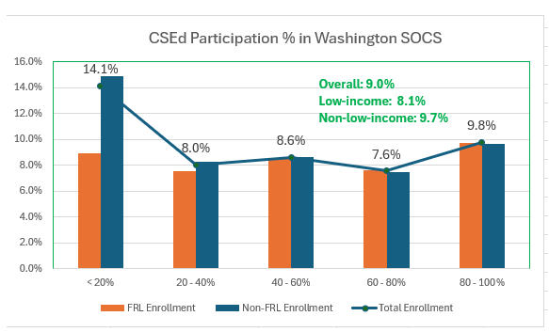
Participation by Income Level
Participation by Income Level
Washington Participation by Race/Ethnicity
National Participation by Race/Ethnicity
SOCS: Schools offering Computer Science
From Lawrence’s blog post The Good, The Could-Be-Better, And The All-Too-Well: Low-Income Students in CSEd Washington 2021-22 - Cranidores.org

Slide 30
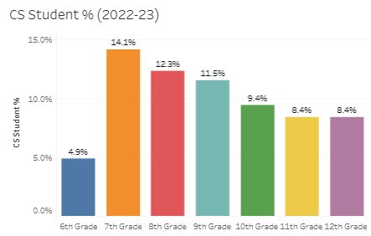
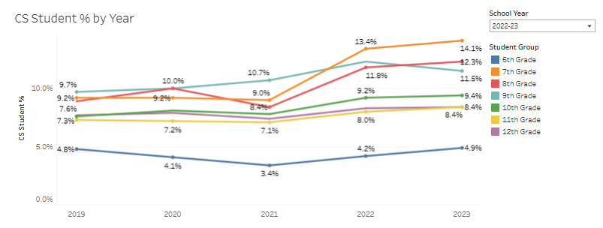
Participation by Income Level
Participation by Grade Level (Washington)
Washington Participation by Race/Ethnicity
National Participation by Race/Ethnicity
from Washington CS Education Demographics 2018-23 on https://csforallwa.org/data

Slide 31
Lack of Middle/Elementary School Data
 | State of Computer Science In Education Report 2024 (National) | 2022-23 K–12 Computer Science Education Data Summary Report. (Washington)
Middle School | Limited data from 19 states. No Washington | Detailed data from 2018 to 2023
Elementary School | Limited data from 18 states. No Washington | No data

Slide 32
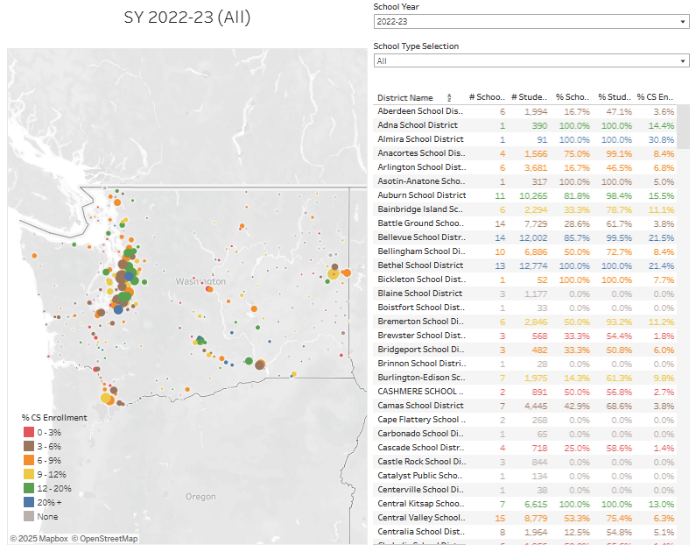
As time permits…
Exploring the visualizations on CS Education in Washington on https://csforallwa.org/data

Slide 33
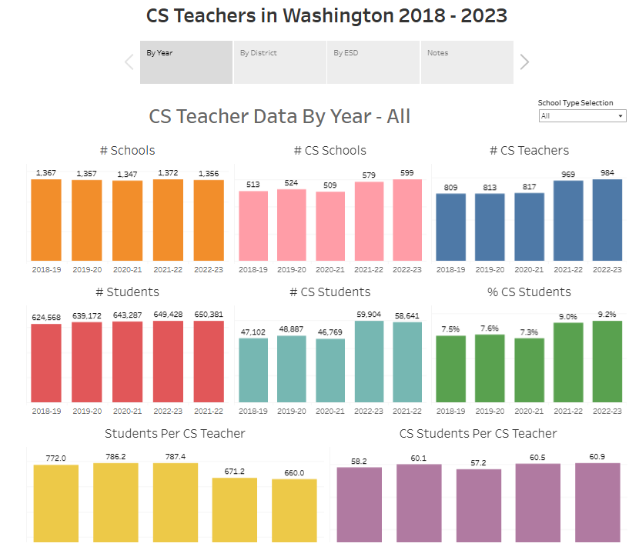
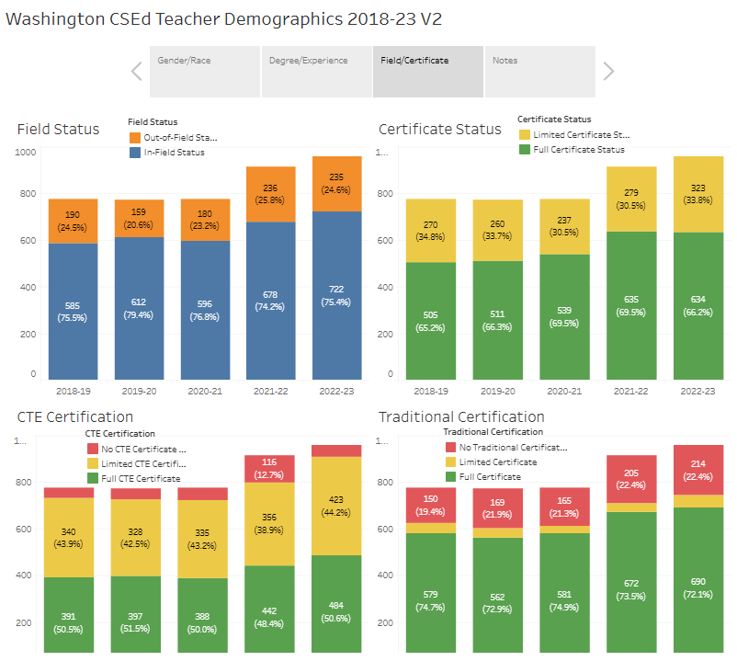
CS Teacher Visualizations on CSforAll Washington

Slide 34
Washington CS Ed Policy Landscape

Slide 35
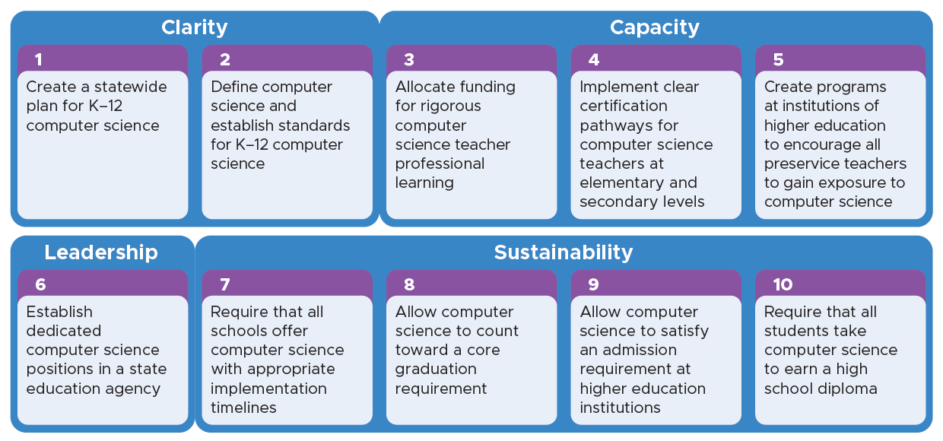
10 Policies to Make CS Fundamental
State of Computer Science In Education Report 2024
Notes:
Talk through any policies that are relevant for your state

Slide 36
How many of the ten policies has Washington implemented? Includes partial implementations
A) 10
B) 8 – 9
C) 6 – 7
D) 4 – 5
E) 3 or less
according to 2024 State of CS Ed Report

Slide 37
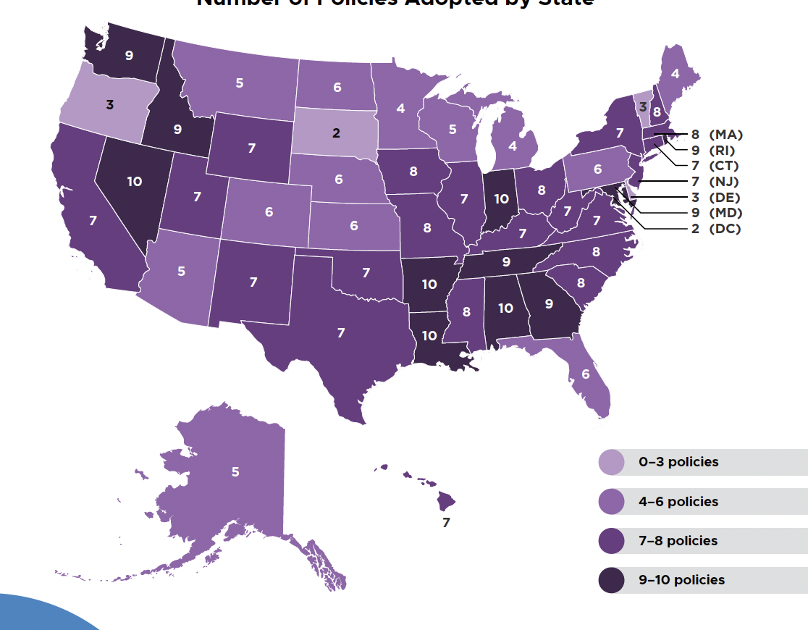

Policies Adopted by State
Notes:
39 states have at least six of the ten policies recommended by the Code.org Advocacy Coalition
States that have at least six policies have an average of 70% of their high schools offering foundational computer science, compared with 52% in states that adopted fewer than six policies

Slide 38
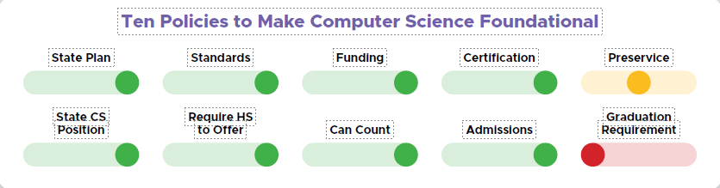
Washington Policy Scorecard (official)

Slide 39
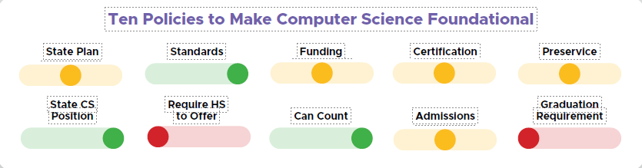

Washington Policy Scorecard (Lawrence’s Interpretation)
What’s Missing???

Slide 40

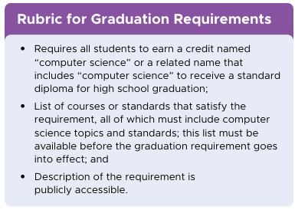
10. Graduation Requirement
Summary: Require that all students take computer science to earn a high school diploma (new in 2023)
SB 5849 (2024) All students must show competency in computer science to graduate from high school. A variety of mechanisms were provided. Passed Senate but stalled in House.
SB 5327 (2025) BOE to develop recommendations to ensure students have competency in high school CS, and consider how to incorporate the competencies into graduation requirements. Passed Senate but stalled in House.
CSforAll Washington Memo (Sep 2024) recommending integration of CS into one or more courses
Official
Lawrence

Slide 41
VT
States with Graduation Requirements
NH
MA
RI
CT
NJ
DE
DC
MD
Passed Graduation Requirement
De Facto Graduation Requirement
Legislation Introduced/Under Consideration
Notes:
De facto means they have a requirement with “computer science” in the name but it isn’t exclusively a computer science credit.
In Mississippi the credit is called “Technology or Computer Science”
In Maryland the credit it called “Computer Science/Engineering/Technology Education

Slide 42


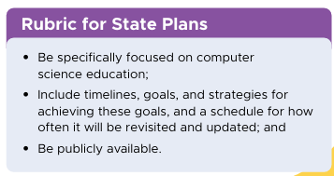
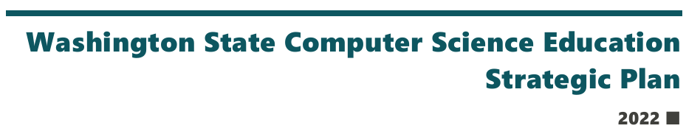
1. State Plan
Summary: Create a statewide plan for K-12 Computer Science
Washington State Computer Science Education Strategic Plan published in Jan 2002
“Living document” never benchmarked, reviewed, or updated after initial publication
Plan scheduled to be completed at end of 2024-25 school year
Official
Lawrence

Slide 43
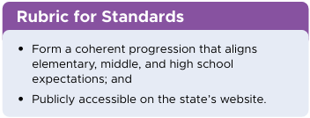
2. Standards
Summary: Define computer science and establish standards for K-12 computer science
HB1813 (2015) Expanding Computer Science Education – OSPI Shall adopt CS learning standards developed by nationally recognized CS education organization
Washington’s Computer Science Standards (2018) duplicate CSTA K-12 Computer Science Standards (2017).
CSTA plans to release updated K-12 CS standards in summer of 2026
SB 5327 (2025) instructs OSPI to adopt new standards by end of 2026.
State definition of computer science
Do students really learn these standards?
Official
Lawrence

Slide 44
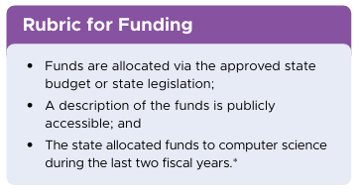
3. Funding
Summary: Allocate funding for rigorous computer science teacher professional learning
Two CS Education grants:
FP777 Computer Science Education Grant ($1 million since 2016-17)
FP656 AP Computer Science Initiative Grant ($62K since 2014-15)
Unknown percentage used for “rigorous computer science teacher professional learning”. See June 2024 Connector - Washington CS Ed Grants (Jun 03, 2024) (csteachers.org) for more details.
These funds may not get in 2025-26 budget.
Is funding enough for current policy? What additional funds are necessary for a graduation requirement
Official
Lawrence

Slide 45
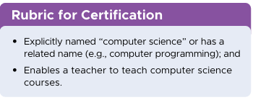
4. Certification
Summary: Implement clear certification pathways for computer science at the elementary and secondary levels
HB 1813 (2015) creates a test-only computer science endorsement and creates the Educator Retooling Scholarship.
Not “clear”, see CS for All Washington - Future Teachers
Issues
Most schools require CTE certification in addition to CS Endorsement
Many endorsements can be used to teach many CS courses
Same CS endorsement for all grade levels
Only 169 teachers have obtained this endorsement from 2017-24
Official
Lawrence

Slide 46
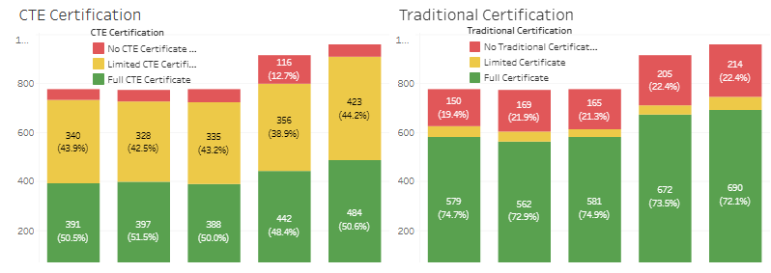
Washington CS Teacher Certifications
94.2% of Washington CS Teachers have CTE Certifications
Only 130 of the 957 teachers teaching CS has passed the CS Endorsement Exam
from Washington CSEd Teacher Demographics 2018-23 on https://csforallwa.org/data

Slide 47
5. Preservice
Summary: Create programs at institutions of higher education to encourage all preservice teachers to gain exposure to computer science
Changed from “Create preservice programs for computer science at higher education institutions” in 2023
Washington has undergraduate computer science teaching programs at Western Washington, Eastern Washington, and Whitworth University.
Master’s programs at University of Washington, Western Washington, WSU Tri-Cities, and Whitworth University
Washington moved from green to yellow in this policy area as it does not require pre-service teachers to learn computer science. May turn to red next year
Official
Lawrence

Slide 48
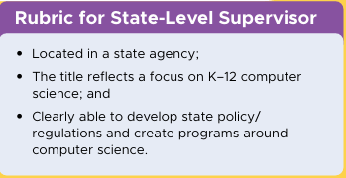
6. State CS Position
Summary: Establish dedicated computer science positions in a state education agency
Terron Ishihara is the Computer Science Program Supervisor for Washington in OSPI. Contact terron.ishihara@k12.wa.us. Sign up for the newsletter here. WinForCS (Washington Integration for Computer Science). CS leaders from all 9 Educational Service Districts, in partnership with OSPI, work together to promote equitable computer science education for all students across Washington state.
Representatives for CS in ESD are part-time, shared with other roles, and depend on funding from FP777 (uncertain for 2025-26 budget)
Official
Lawrence

Slide 49
7. Require HS to Offer
Summary: Require that all schools offer computer science with appropriate implementation timelines
SB 5088 (2019) required that each school district that operates a high school must provide access to an elective computer science course by the 2022–2023 school year.
In the 2022-23 school year, only 47% of Washington high schools had a student enrolled in a CS elective. Up to 60% offered in course catalog.
Official
Lawrence

Slide 50
8. Can Count (toward graduation)
Summary: Allow computer science to count toward a core graduation requirement
There is considerable flexibility for CS to count toward a core graduation requirement as a third-year math or science. RCW 28A.230.300 applies to all CS courses listed in Appendix V of OSPI's CEDARS.
See Jan 2025 CSTA Washington Connector “CS as a 3rd year math or science”
Official
Lawrence

Slide 51
Courses that can count toward 3rd Year Math or Science

Slide 52
9. Admissions (to higher ed)
Official
Lawrence
Summary: Allow computer science to satisfy an admission requirement at higher education institutions
Washington's public four-year college and universities do not recognize any CS course as a 3rd year math or science. Or fulfill any other core requirement.
The only exception is that AP CS A may be used as a senior-level (i.e., fourth-year) math course.
Because of the current 24-Credit Career- and College-Ready Graduation Requirements is already quite full, many students may need to make a choice between taking CS or going to college
See Jan 2025 Connector “CS as a 3rd year math or science”

Slide 53
What’s Missing?

Slide 54
In Defense of the 10 Policies
Designed to attract bi-partisan support in all 50 states.
Politician, government official friendly
Budget and budget earmark policy recommendations are a no-win
Up to all of us!

Slide 55
Other Policy Recommendations
CSforAll Washington Policy Page
Computer Science Teachers Association (CSTA)
Guidance for Policymakers
CS Teacher Landscape Report Recommendations
ECEP Alliance Resources
Lawrence’s Recommended Changes for the Ten Policies
State plan must include how to promote computer science education in elementary and middle school.
State must publish detailed data on the competency and experience of students in computer science in elementary, middle, and high school
State must publish detailed data on the credentials held by and support provided to teachers of computer science and how it compares to other subjects

Slide 56
Thank you
tanlaw@hotmail.com
https://tinyurl.com/stateofcsewa25

Slide 57
Survey and Clock Hours
QR Code Here
3 clock hours available for all interested attendees
Please confirm attendance on sign up sheet today
Please fill in survey by EOD 4/29/2025

