Slide 1

The Difference Between Washington’s EdTech and CS Education Standards
Lawrence Tanimoto
Treasurer/Advocacy Lead
CSTA Washington

Slide 2

Lawrence Tanimoto
Treasurer/Advocacy Lead, CSTA Washington
Currently Retired Teacher (CTE) at Ingraham High School in north Seattle from 2014-2021
28 years in international computer industry last 18 with Microsoft https://www.linkedin.com/in/lawrence-tanimoto/l

Slide 3

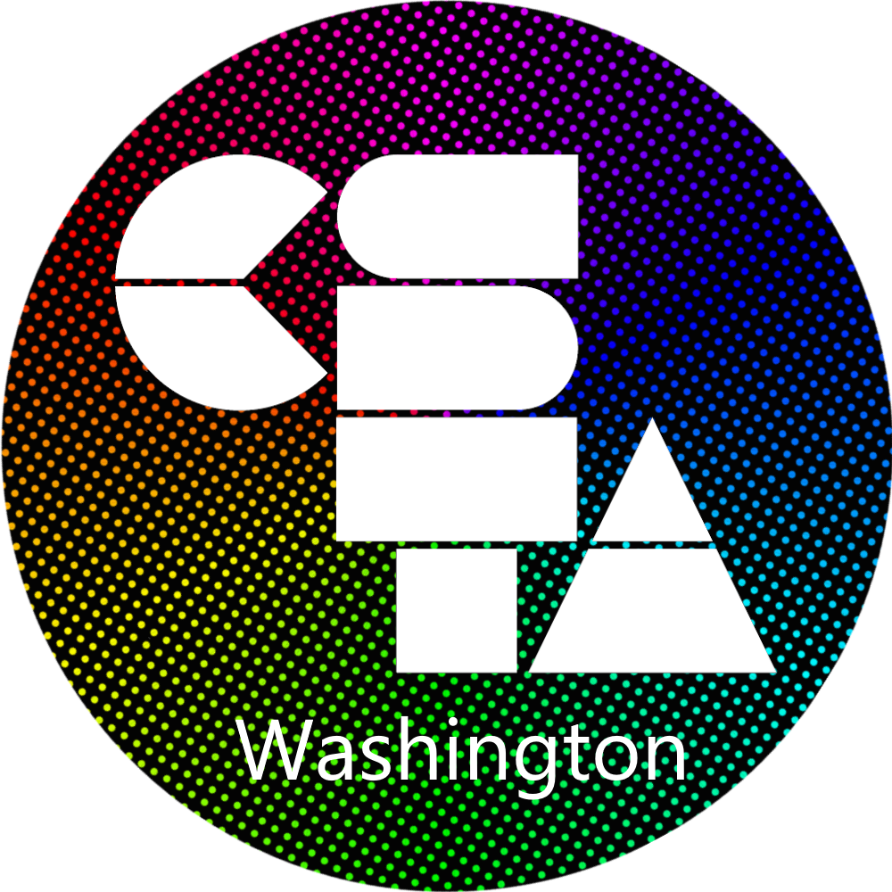
Computer Science Teachers Association
Merger of 4 CSTA chapters in Washington (Nov 2025)
Puget Sound
Central Washington
Mid-Columbia
Spokane
Active chapter with over 370 members
https://washington.csteachers.org
Join Us! (It’s free)

Slide 4
Washington EdTech & CS Standards
Notes:
https://ospi.k12.wa.us/student-success/resources-subject-area/educational-technology-edtech/educational-technology-learning-standards?utm_source=chatgpt.com

Slide 5

What is the difference between EdTech and Computer Science classes?
https://pollev.com/freeflower916

Slide 6
Washington’s EdTech Standards
Goal Three of the Washington Basic Education Act requires schools to “integrate technology literacy and fluency” in their curriculum.
Original version developed in 2008
Standards updated in 2018 by adopting the 2016 International Society for Technology in Education (ISTE) Standards for Students.
Washington’s EdTech standards are much more detailed than 2024 ISTE Standards for Students
Grade bands
Examples of student performance
Connected standards (C3 (College, Career, Civic Life), CSTA CS Standards, Health, ELA, Math, PE, Science)
Scope and Sequence

Slide 7
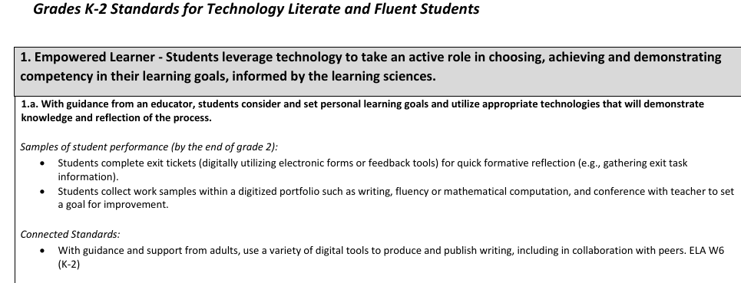
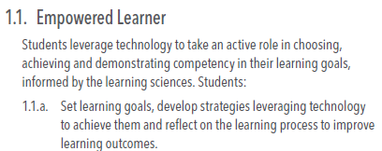
ISTE Student vs Washington EdTech Standards
Washington EdTech
ISTE Student
2 pages
59 pages

Slide 8
Washington’s Computer Science Standards
HB1813 (2015) Expanding Computer Science Education – OSPI Shall adopt CS learning standards developed by nationally recognized CS education organization
Washington’s Computer Science Standards (2018) duplicate CSTA K-12 Computer Science Standards (2017). Washington standards remove descriptive statement, subconcept, and practices info.
CSTA plans to release updated K-12 CS standards in summer of 2026.
CSTA in partnership with ISTE released updated Standards for Computer Science Teachers in 2020. NBPTS does not provide CS Teacher Standards.

Slide 9
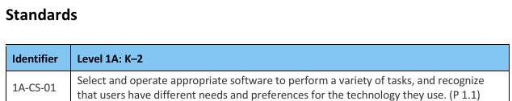
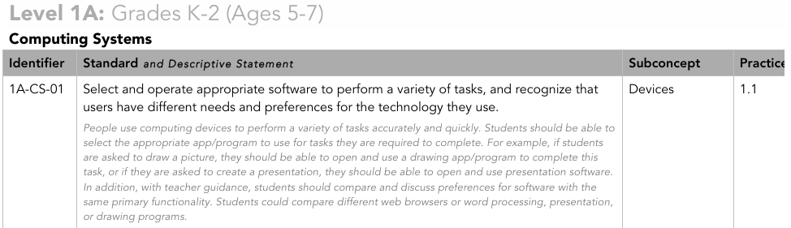
Washington vs. CSTA CS Learning Standards
Washington
CSTA

Slide 10
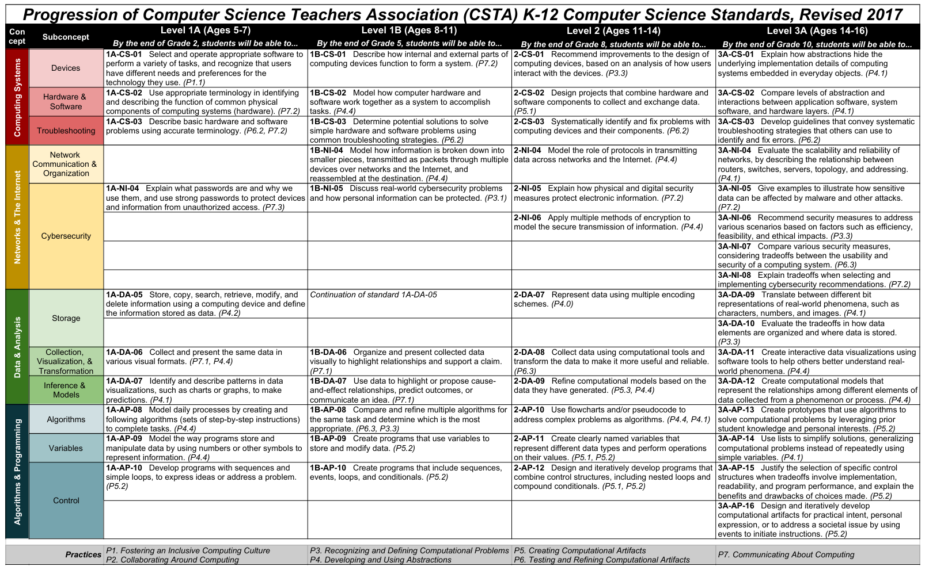
CSTA K-12 CS Standards Progression Chart

Slide 11
EdTech and CS Crosswalk

Slide 12
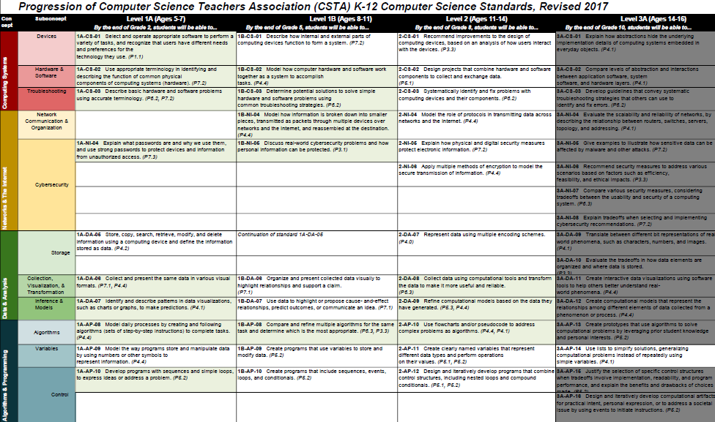
CS Standards Covered By EdTech Standards
Excel Link | PDF Link

Slide 13
About the Chart
White – “Lawrence’s Initial Recommendation” CS graduation requirement (per SB 5849 (2024) and SB 5327 (2025) ).
Includes Lists (3A-AP-14)
Light Green – CS Standards mentioned in Washington’s EdTech Standards
Dark Grey – Not in “Lawrence’s Initial Recommendation”.
All Level 3A (Grade 10) except lists
EdTech Standards mention 3A-IC-29, 3A-AP-16 only
Level 3B (Grades 11-12) of CS Standards Not Included In Progression Chart
Level 3B is intended for high school students who wish to pursue the study of computer science beyond what is required for all students (i.e., in specialty or elective courses).

Slide 14
Gradual Diversion
Level | Grades | # EdTech Mentions | Total # Standards | Percentage
1A | K-2 | 10 | 18 | 56%
1B | 3-5 | 11 | 22 | 50%
2 | 6-8 | 4 | 23 | 17%
3A | 9-10 | 2 | 30 | 7%

Slide 15
Missing Subconcepts
Variables (including Lists)
Storage
1A-DA-05 Store, copy, search, retrieve, modify and delete information using a computing devices
2-DA-07 Represent data using multiple encoding schemes.
Culture

Slide 16

So What Can You Do?

Slide 17
Computational Thinking

Slide 18
Computational Thinking Definitions
COMPUTATIONAL THINKING (CT)
The set of thought processes traditionally used by computer scientists to understand and solve problems, but which also can be used by anyone in any field.
DECOMPOSITION - The process of breaking something large into smaller, more manageable pieces.
PATTERN RECOGNITION - The process of identifying similarities, differences, and repetition in a set of information or data
ALGORITHMS - A step-by-step process to achieve a goal
ABSTRACTION - The process of filtering complex or detailed information to create a simplified version or representation.
Note: Different versions exist
Notes:
Making Abstraction Concrete in the Elementary Classroom SIGCSE FINAL v1.5 - Google Slides (from SIGCSE 2024 Hung, Vanderberg. Krause.
Other references
Understanding Computational Thinking for More Effective Learning
Amazon.com: Computational Thinking and Coding for Every Student: The Teacher’s Getting-Started Guide: 9781506341286: Krauss, Jane, Prottsman, Kiki: Books

Slide 19
Which computational thinking skill is the most difficult?
https://pollev.com/freeflower916

Slide 20
POST-SURVEY RESULTS
Number of teachers (n=20) self-reporting struggle with…
PATTERN RECOGNITION
DECOMPOSITION
ABSTRACTION
ALGORITHMS
0
1
15
1
Making Abstraction Concrete in the Elementary Classroom (SIGCSE 2024 Presentation (Hung, Vanderberg, Krause, Skuratowicz)

Slide 21
It’s All About Abstraction

Slide 22
Variables Are Abstractions
Lists Are Abstractions of Many Variables

Slide 23
Data and Algorithmic Abstraction
Abstraction is the process of filtering complex or detailed information to create a simplified version or representation.
Data abstraction is the process of hiding the complex implementation details of data structures and exposing only the essential features necessary for interacting with the data. It allows programmers to work with data at a higher conceptual level without worrying about low-level operations.
Algorithmic abstraction is the process of designing algorithms by focusing on high-level operations while ignoring low-level implementation details. It allows programmers to describe what an algorithm should do rather than how each step is executed in detail.
Notes:
Courtesy of ChatGPT

Slide 24
Modern Digital World Built Upon Layers of Abstraction
Each layer of abstraction simplifies the layer below it.
By building on the top layers, we can take easy advantage of all the layers of accumulated computer science knowhow below it
Any sufficiently advanced technology is indistinguishable from magic. Arthur C. Clarke

Slide 25
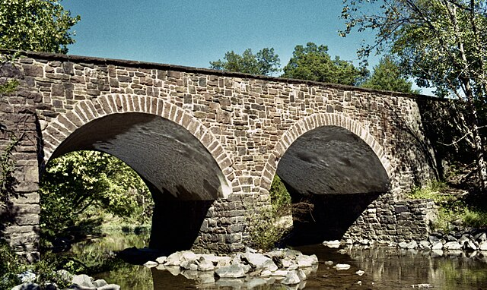
The Bridge of Abstraction
Abstraction helps explain
why all students need to learn some computer science, but
not everyone needs to major in it.
Abstraction in CS provides the literacy between
math - precise but lacks context, and
natural language - provides context but is imprecise
Abstraction provides the bridge language between
humans - who often know what they want to do - even if they can't do it well, and
computers - which don't know what they want to do but do it incredibly well if given the correct instructions.
Notes:
<a href="https://www.nps.gov/mana/learn/historyculture/places.htm" rel="noreferrer nofollow">The Stone Bridge</a> at Manassas National Battlefield Park in Manassas, Virginia.

Slide 26
EdTech Primarily Deals with the Top Layer of Abstraction

Slide 27
Data Abstraction

Slide 28

A Simple Scratch Program

Slide 29
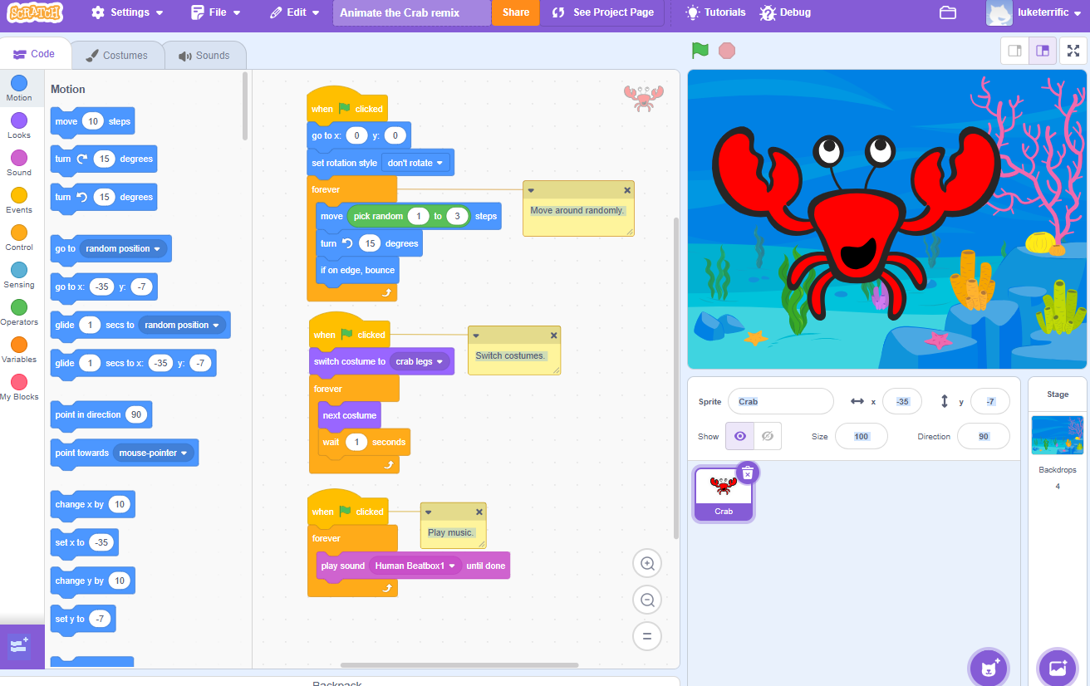
Layers of Data Abstraction (I)
Pictures: Not a real crab or real ocean floor
Layers: Crab picture appears in front of ocean floor picture
Position: Crab picture moves just by moving the center on x-y grid

Slide 30
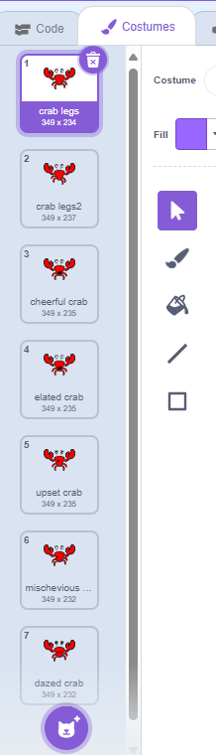
Layers of Data Abstraction (II)
Movement: Movement within a picture is created by cycling through a list of costumes each of which is a picture
Pictures: Each picture is a list of pixels - dots in a screen.
Pixels: Each pixel has a color represented by the three numbers representing the amount of red, green, and blue. 256 shades of each for 16.8 million colors.
Numbers: Each number from 0-255 is represented by 8 bits. Bits are what computers understand

Slide 31
Why do computers use bits?
Which is easier for a computer to read 77?

Slide 32
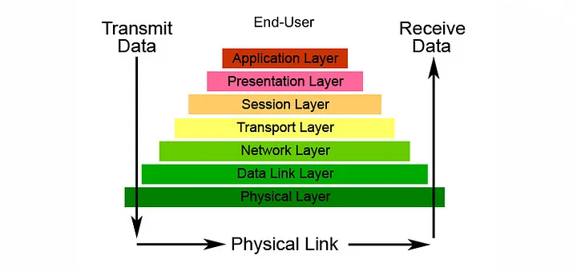
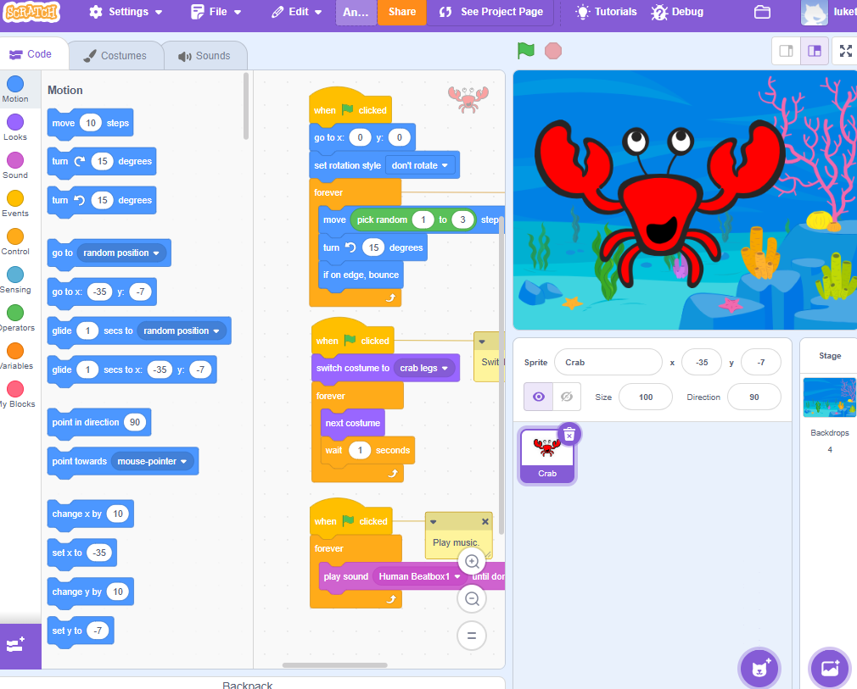
Networking: Open Systems Interconnect 7 layers
https://scratch.mit.edu/projects/1130556998/editor/
https://medium.com/@kinseymatthews/osi-model-the-seven-layers-of-networking-03ab34b31ac6
Notes:
https://medium.com/@kinseymatthews/osi-model-the-seven-layers-of-networking-03ab34b31ac6

Slide 33
Algorithmic Abstraction

Slide 34

The humble Python print() function
print("Hello",username)
>> Hello Lawrence
Notes:
Built-in Functions — Python 3.13.2 documentation

Slide 35
Abstraction in print()
print()
Functions called by print()
Code executed by print()
A function is an abstraction. The print() function hides much algorithmic complexity
Each of the arguments is a variable – an abstraction.
Notice *objects. This indicates a list of objects. We can indicate several objects to print in the same function
An object as in “object-oriented programming” contains both attributes and methods. It abstracts both data and algorithms.

Slide 36
Abstraction in Your Own Programs
The more complex your programs are, the more you should be using functions -either your own or those created by others
Avoid:
Writing complex logic directly in the main body.
Duplicating code that could be placed inside functions.
Mixing too many responsibilities in one place
How this changes the the task of programming.

Slide 37
From one to billions lines of code
python.exe myProgram.py
Interpreting and loading requires OS to execute billions of lines of machine code
Running your python code
Few lines of code in your main program
Calls Python functions both that you wrote and others wrote and may call yet other Python functions
Must be converted into several times more lines of bytecode and then is interpreted by the Python engine (generally written in C/C++) to determine what machine code should be run
C/C++ code will call other C/C++ functions to convert, interpret and execute the billions of lines of machine code
Machine code commands are simple – a single binary numbers

Slide 38
Original x86 Machine Instruction Set
Instruction | Description | Binary Code
 | …
ADC | Add with carry | 0x10...0x15, 0x80...0x81/2, 0x83/2
ADD | Add | 0x00...0x05, 0x80/0...0x81/0, 0x83/0
AND | Logical AND | 0x20...0x25, 0x80...0x81/4, 0x83/4
CALL | Call procedure | 0x9A, 0xE8, 0xFF/2, 0xFF/3
 | …
WAIT | Wait until not busy | 0x9B
XCHG | Exchange data | 0x86, 0x87, 0x91...0x97
XLAT | Table look-up translation | 0xD7
XOR | Exclusive OR | 0x30...0x35, 0x80...0x81/6, 0x83/6
https://en.wikipedia.org/wiki/X86_instruction_listings
90 instructions

Slide 39
Conclusions

Slide 40
Conclusions
Understand how well EdTech standards cover CS standards using:
Washington’s detailed EdTech standards, and
CSTA’s standards progression chart with subconcepts
Abstraction is the computational thinking concept
Missing from EdTech standards
Most difficult for elementary/middle school teachers to understand
Understanding the power of layers of abstraction is critical to explaining
Why all students need to learn basic computer science
Why computer science is the bridge literacy between math and natural language
How humans can work with computers

Slide 41
Thank you!
Lawrence Tanimoto
CSTA Washington
https://washington.csteachers.org
Lawrence.Tanimoto@outlook.com
https://www.linkedin.com/in/lawrence-tanimoto/

Slide 42
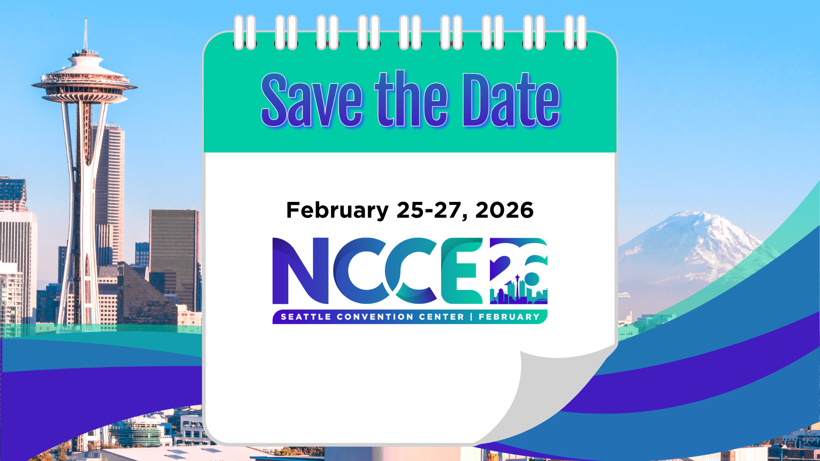

Slide 43


Slide 44


Slide 45
